Slide 1

CUSTOMER LIFE TIME VALUE (CLV) PREDICTIONS
Auto Insurance Company

Slide 2
V
Slide 1
Model Building
Problem Statement and Business Overview
R2 Evaluation
Data Insights
Data Pre Processing and Feature Engineering
Conclusion and Recommendations
AGENDA

Slide 3
OVER VIEW
Objective
We are expected to create an analytical and modelling framework to predict the lifetime value of each customer based on the quantitative and qualitative features.
A major non-life insurance company wants to evaluate customer lifetime value based on each customer’s demographics and policy information including claim details.
The CLV is a profitability metric in terms of a value placed by the company on each customer and can be conceived in two dimensions: the customer`s present Value and potential future Value.

Slide 4
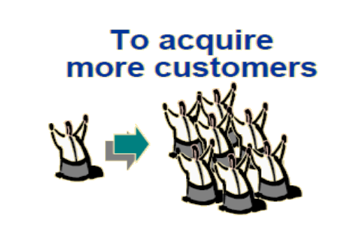
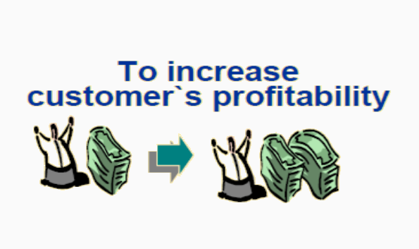
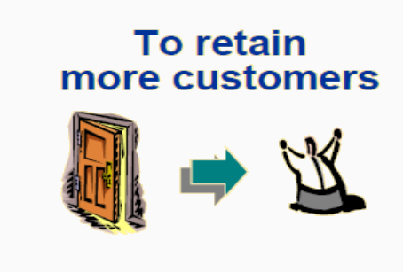
BUSINESS STRATEGIES

Slide 5
CUSTOMER LIFE CYCLE
More Efficient Customer Retention
Better Cross / Up selling
PROFIT
More Efficient acquisition of new customers
Recovery of Potential Valuable Customers
PROFIT
Faster Termination of Less Valuable Customer
TIME
Acquisition
Retention
Termination

Slide 6
CLV HELPS TO ANSWER THIS……
More Efficient Customer Retention
Better Cross / Up selling
Do the Customer have high probability of cross-selling?
Do the Customer have high potential?
PROFIT
More Efficient acquisition of new customers
Recovery of Potential Valuable Customers
Do the Customer have low potential?
Do the new customer has same profile as valuable customer?
PROFIT
Faster Termination of Less Valuable Customer
TIME
Acquisition
Retention
Termination

Slide 7
Components Used in Dashboard
1. Parameters Used
Business centric parameter
Customer centric Parameter
Demographic Parameter
2. Combine sets used for Top 5 and Bottom 5 Customers.
3. Information and navigation button.
4. Histogram for all variables in Tooltips.

Slide 8
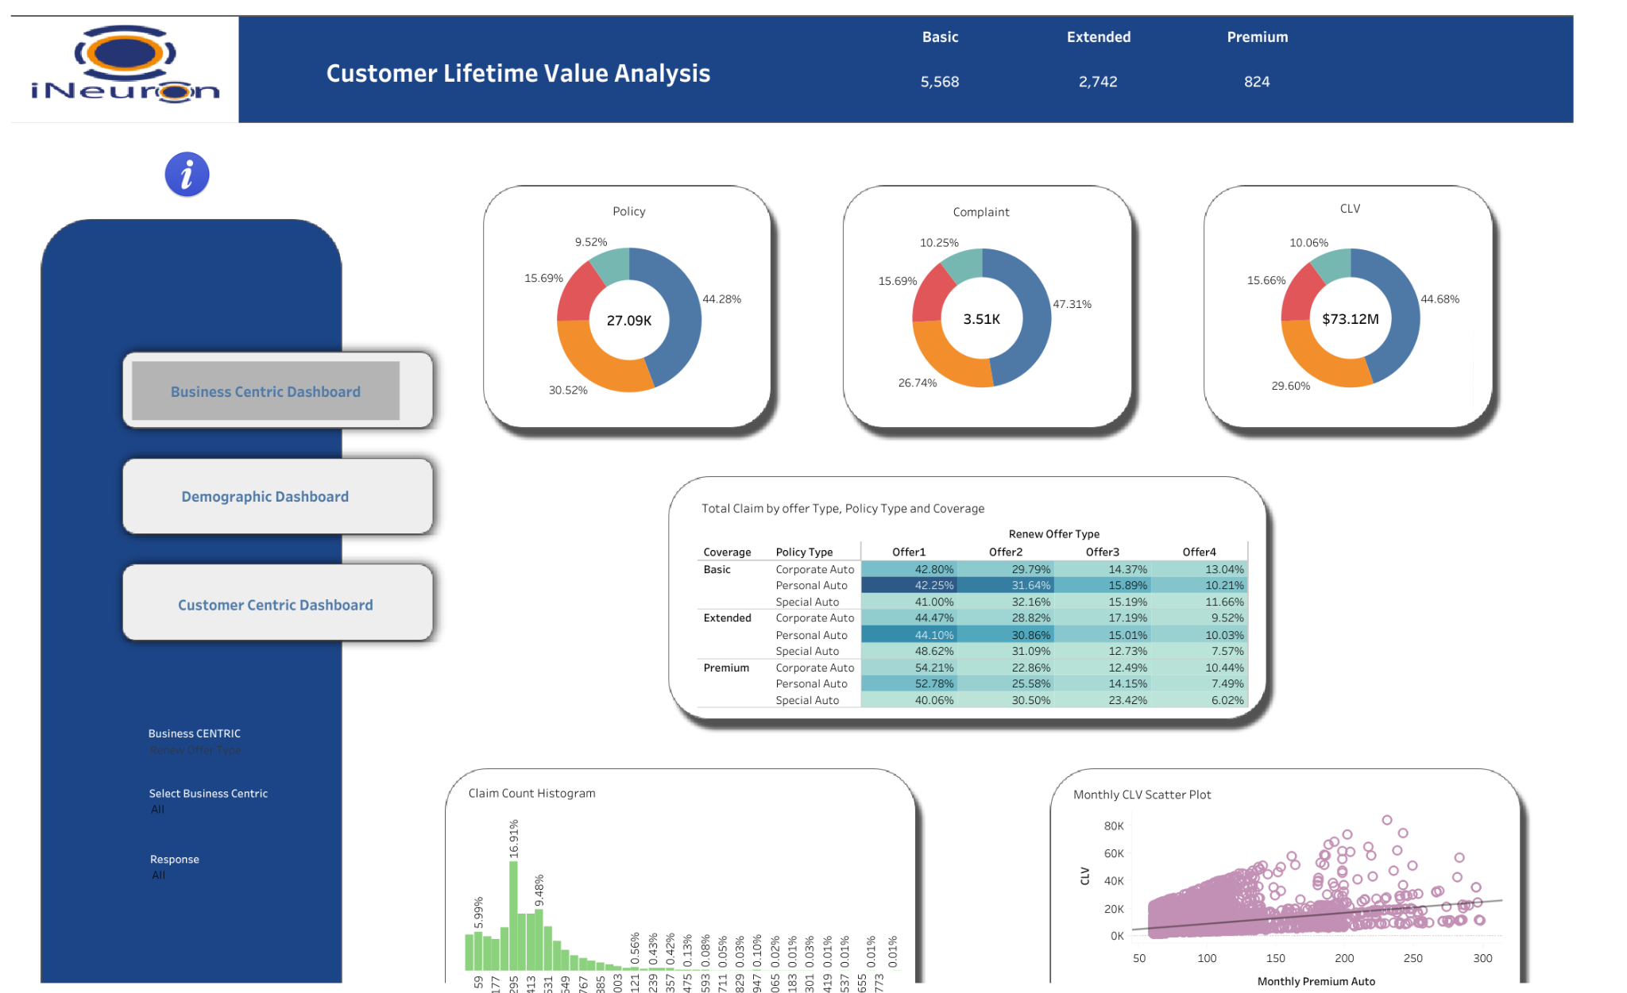
Business Intelligence Dashboard

Slide 9
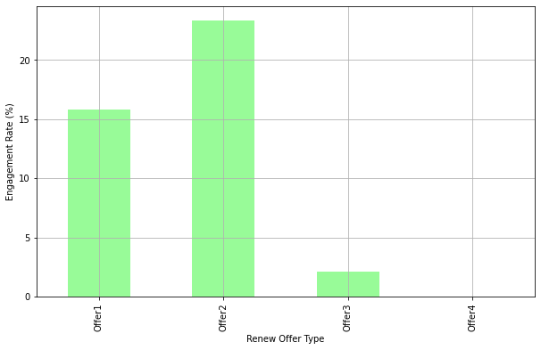
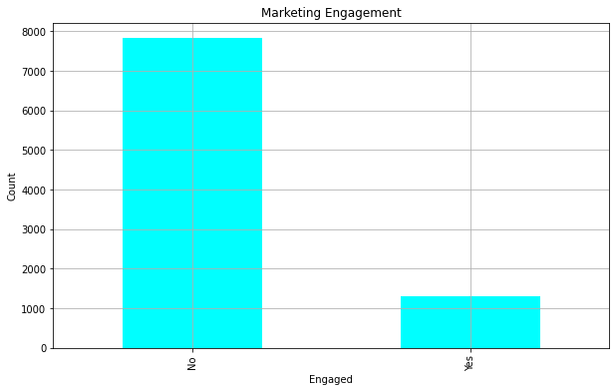
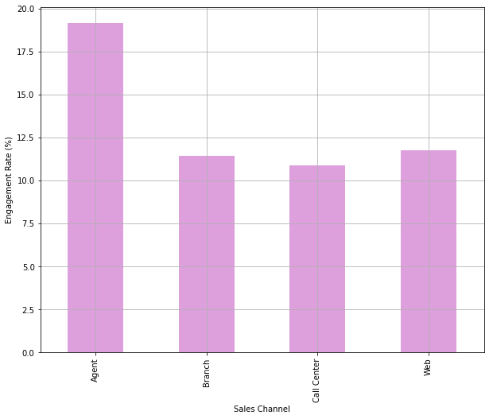
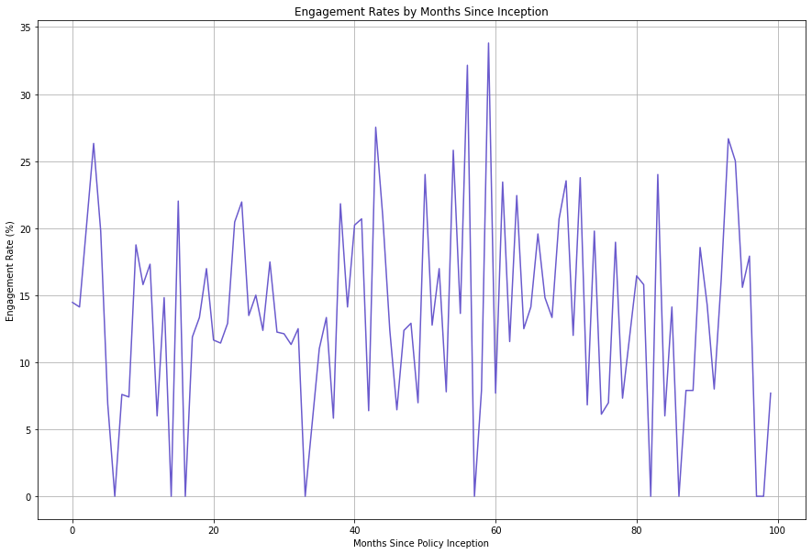
Customer Engagement Analysis

Slide 10
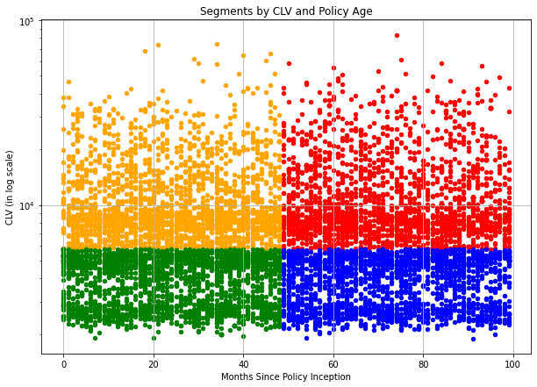
Policy Age segment= Months Since Policy Inception > median, high else Low
CLV segment = CLV > median, High else Low
CS=High
PAS=High
CS = Low
PAS= Low
CS = High
PAS=Low
CS = Low
PAS= High

Slide 11
DATA PRE-PROCESSING AND FEATURE ENGINEERING
Data Pre-Processing
Feature Engineering
Variables Extraction
Dataset was given with 9134 data points and 24 variables.
There is no missing value
Drop columns those add no significance.
A new Features are been extracted based on the existing variables.
New Features are:
Present Value of Customer,
Clubbing the Various Levels into one level.
Applied one hot encoding for categorical columns
See the correlation features.
Using the VIF and statistical analysis some of the variables are been removed.

Slide 12
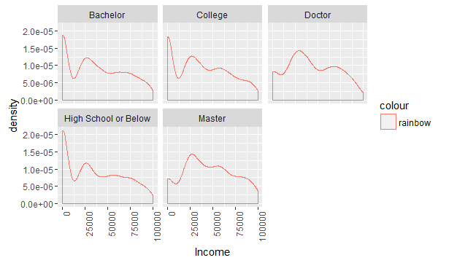
FEATURE ENGINEERING
Monthly Premium Amount
Present Value of Customer
=
a*
-
Total Amount Claim
Months since policy Inception
Bachelor
College
High School or Below
Doctor
Master

Slide 13
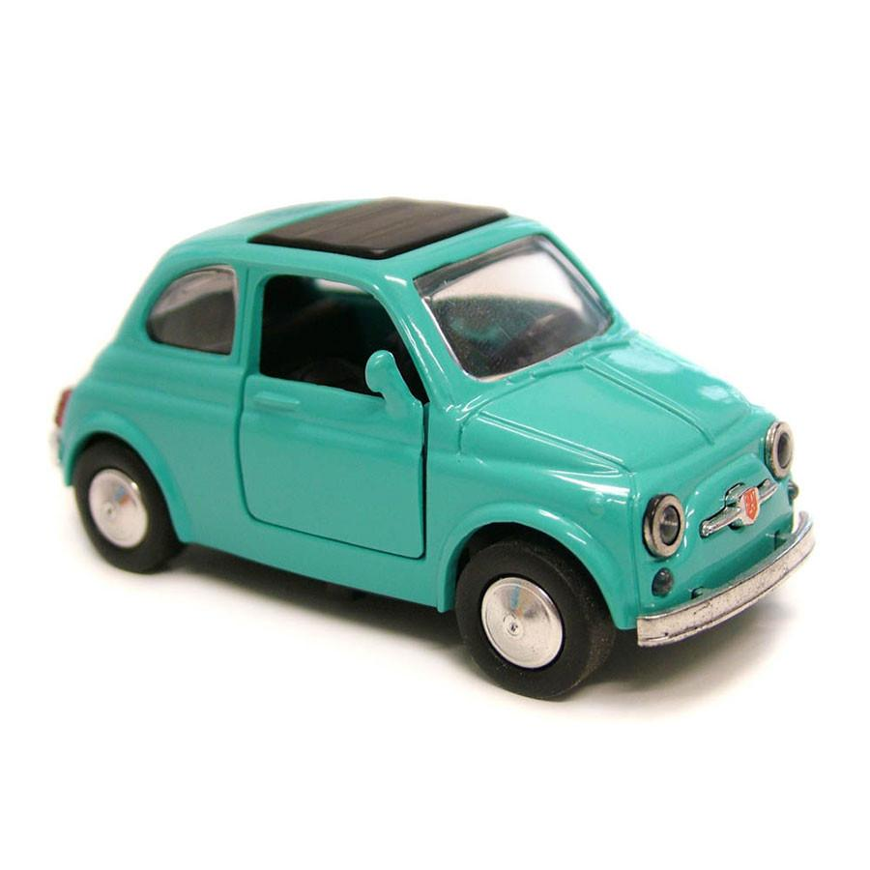

DEMO GRAPHS OF THE FINAL DATA FRAME
Initial Data Frame with 9134 data points and 24 feature variables
Transformation
Customer Centric | Business Centric | Customer Demo+ graphs
Income | Sales Channel | Education
Employment status | Monthly Premium Value | Marital Status
No. of Policies | Policy & Offers | Location
Vehicle Class | Coverage | Gender
Dataset Summary:
Total Observations : 9134
Total variables : 24
Split : 70-30
Target Variable : Customer Life Time Value
Scaling : Based on the model
Evaluation Metric : R2

Slide 14
Statistical Analysis
Proceed with non parametric tests since the dependent variable is not normally distributed
Shapiro–Wilk test
Mann-Whitney U test
Kruskal-Wallis H-test
Assumption
No Auto correlation = Durbin- Watson Test
Normality of Residuals = Jarque Bera test
Linearity of residuals = rainbow test
Homoscedasticity Test = Goldfeld Test
No Multi colinearity = VIF

Slide 15
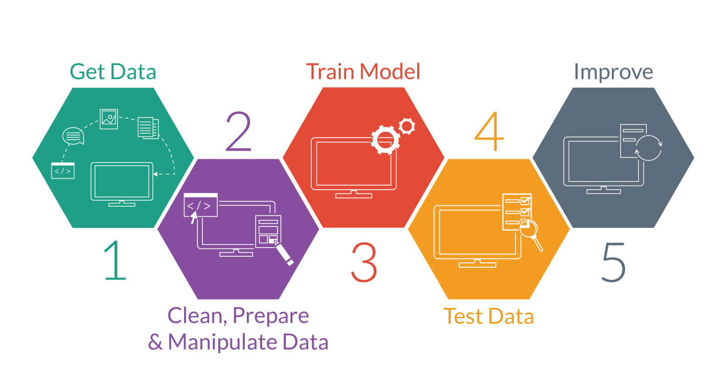
MODEL BUILDING

Slide 16
Models | R^2
Linear Regression | 0.25484160264997946
Ridge Regression | 0.2148084953609083
Decision Tree | 0.840787974934538
Random Forest | 0.9139544276201418
Hyperparameter Random Forest | 0.9123540914308492
Hyperparameter Adaboost | 0.8945253809639656

Slide 17
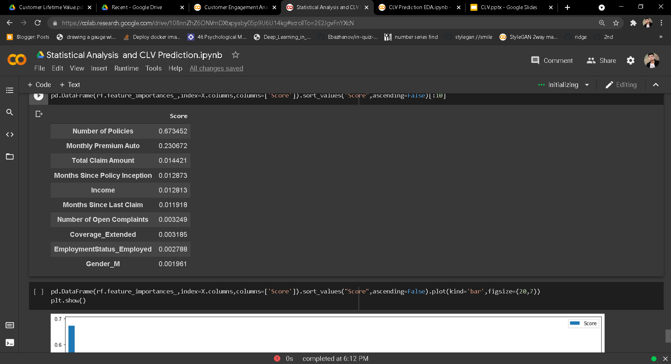
Features Importance

Slide 18
CONCLUSION AND RECOMMENDATIONS
As the Customer who is using Four Door Car and Two Door car more inclined to coverages and even the Loss incurred by them is more.
Focus on male customers and promote offer 3 and offer 4.
Even Group 3 Can be Bought in to Group 4 by giving offers to them and even new attracting policies.
Apply better sales strategy for Doctor’s and master’s students as they are busy
Concluding that Random Forest Model is stable in order to predict the CLTV.
Made By J Sai Charan

Slide 19
THANK YOU
Made By J Sai Charan

